Slide 1




Cybercrime and Digital Forensics (COM622)
Department of Science & Engineering
Solent University
Week 10 Lecture: Cybercrime prevention –Strategies, Policies and Programmes
Dr Daniel Olabanji

Slide 2

Session Overview
Cybercrime revisit
Cybercrime and Trending Technology
Key Principle of Cybercrime Prevention
Future Trends in Cybercrime Prevention

Slide 3
Cybercrime
Pure cybercrime - unauthorised access to computer systems and data, and acts against the confidentiality, integrity and accessibility of a computer
Crimes relating to computer content - offences such as the production, distribution or possession of child pornography (including sextortion), content related to terrorism, racism or xenophobia, and intellectual property infringement (such as software, music and videos, or pharmaceuticals), hate crimes, harassment, bullying, and political extremism
Crimes for personal or financial gain - most expansive, category - payment card fraud, banking fraud, fraud on auction sites, advanced fee fraud, targeting of personal information, fraud through social networking sites, forgery, stranded traveller scams, 419 scams and identity theft

Slide 4
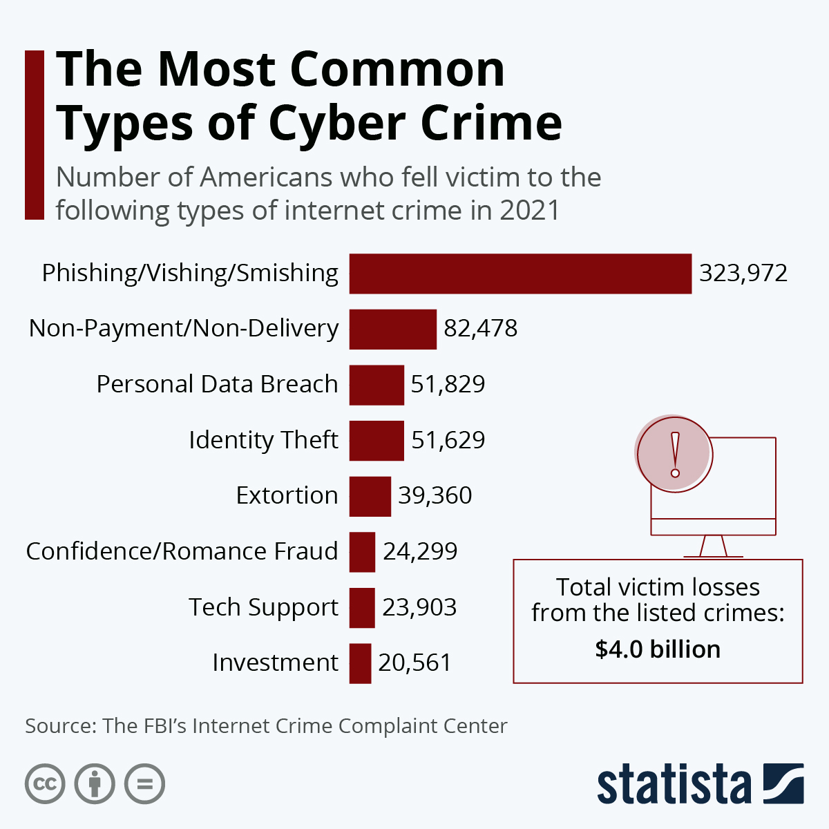
Type of Cybercrime
Cyber enable cybercrime
Identity theft
Personal Data Breach
Confidence/Romance Fraud
Extortion
Terrorism
Distributing Child Pornography
Cyber dependent cybercrime
Hacking
Phishing
Computer Malware
Ransomware
Online grooming

Slide 5
Impact of Cybercrime
Individuals
Financial Losses
Emotional and Psychological Impact
Privacy Invasion
Businesses
Financial Costs
Reputational Damage
Operational Disruption
Legal and Regulatory Consequences
Governments
National Security Threats
Economic Impact
Public Trust and Confidence.
International Relations

Slide 6
Cybercrime and Trending Technology
Ransomware Attacks: Ransomware remains one of the most prevalent and damaging forms of cybercrime. Attackers encrypt victims' data and demand a ransom for its release. The rise of ransomware-as-a-service (RaaS) has made it easier for less skilled cybercriminals to launch attacks
Phishing and Social Engineering: Phishing attacks, where attackers trick individuals into revealing sensitive information, continue to be a major threat. Social engineering tactics are becoming more sophisticated, making it harder for individuals to recognize fraudulent communications
Cryptojacking: With the increasing value of cryptocurrencies, cryptojacking has become more common. This involves unauthorized use of someone’s computer to mine cryptocurrency, often without the victim's knowledge
Supply Chain Attacks: Cybercriminals are increasingly targeting supply chains to gain access to larger networks. By compromising a supplier, attackers can infiltrate multiple organizations

Slide 7
Technological Developments Impacting Cybercrime
Artificial Intelligence (AI) and Machine Learning (ML): AI and ML are being used by both cybercriminals and cybersecurity professionals. Attackers use AI to automate attacks and improve their success rates, while defenders use it to detect and respond to threats more effectively. E.g. Deepfake videos
Internet of Things (IoT): The proliferation of IoT devices has expanded the attack surface for cybercriminals. Many IoT devices have weak security measures, making them vulnerable to attacks.
Blockchain Technology: While blockchain offers enhanced security for transactions, it also presents new challenges. Cybercriminals exploit vulnerabilities in smart contracts and decentralized applications (dApps) to steal funds.
Quantum Computing: Quantum computing has the potential to break current encryption methods, posing a significant threat to data security. However, it also offers opportunities for developing new, more secure encryption techniques.

Slide 8
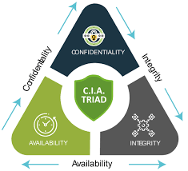
Key Principle of Cybercrime Prevention
Confidentiality: Ensuring that sensitive information is accessible only to those authorized to access it. This involves using encryption, access controls, and secure communication channels
Integrity: Maintaining the accuracy and reliability of data. This includes protecting data from unauthorized modification or deletion through measures like checksums, hashing, and digital signatures.
Availability: Ensuring that information and resources are available to authorized users when needed. This involves implementing redundancy, failover mechanisms, and robust backup solution

Slide 9
Key Principle of Cybercrime Prevention cont.
4. Risk management: Identification and evaluating risks and the implementation of the measures to reduce the likelihood and impact of risks. This includes deploying security controls, conducting regular security audits, and updating systems and software.
5. Awareness and training: This is another key principle for cybercrime prevention which leverage on educating user on the cybercrime and cybersecurity and how to prevent or provide emphasis on the important of vigilance and proactive behaviour toward cybercrime prevention.
6. Regulation compliance and awareness : Complying with relevant laws, regulations, and industry standards, such as GDPR, CCPA, and ISO/IEC 27001. Likewise, the awareness of the law that guild cybercrime and cybersecurity. Compliance helps ensure that organizations implement necessary security measures and protect sensitive data.

Slide 10

Security Policies and Law
ACPO Good Practice Guide
General Data Protection Regulation (GDPR)
Health Insurance Portability and Accountability Act (HIPAA)
Payment Card Industry Data Security Standard (PCI DSS)
Federal Information Security Management Act (FISMA)
Computer Misuse Act 1990
Fraud Act 2006
Several other law and regulation

Slide 11
Technology Solution for cybercrime prevention
Firewalls: Firewalls act as a barrier between trusted internal networks and untrusted external networks. They filter incoming and outgoing traffic based on predefined security rules, blocking unauthorized access while allowing legitimate communication
Encryption: Encryption converts data into a coded format that can only be read by someone with the correct decryption key.
Intrusion detection systems: These systems monitor network traffic for suspicious activity and can automatically take action to prevent potential threats.
Antivirus Software: This is also known as anti-malware, is a computer program used to prevent, detect, and remove malware. There are different type of antivirus software which are based on the type of virus or malware that the antivirus is aiming to prevent.
Multi-Factor Authentication (MFA): MFA requires users to provide two or more verification factors to gain access to a resource, such as a password and a fingerprint
Security Information and Event Management (SIEM): SIEM systems aggregate and analyze activity from various resources across an IT infrastructure. They provide real-time analysis of security alerts generated by applications and network hardware

Slide 12
Future Trends in Cybercrime Prevention
Zero-Trust Architecture: Adopting a zero-trust approach, where no one is trusted by default, even within the network, is becoming a key strategy in cybersecurity. This involves continuous verification of user identities and strict access controls.
Enhanced Threat Intelligence: Organizations are investing in advanced threat intelligence to stay ahead of cybercriminals. This includes using AI to predict and identify potential threats before they can cause harm.
Regulatory Compliance: Governments are implementing stricter regulations to protect data and ensure organizations follow best practices in cybersecurity. Compliance with these regulations is crucial for preventing cybercrime.
Cybersecurity Education and Awareness: Increasing awareness and education about cybersecurity threats and best practices is essential. Training employees and the public can significantly reduce the risk of cybercrime.

Slide 13
Reference
  Mandia Kevin, Chris Prosise, Matt Pepe (2003) “ Incident Response and Computer Forensics” MacGraw Hill

